Slide 1
Input Device: Scanner (2D)
CSE 315
Peripherals & Interfacing

Slide 2


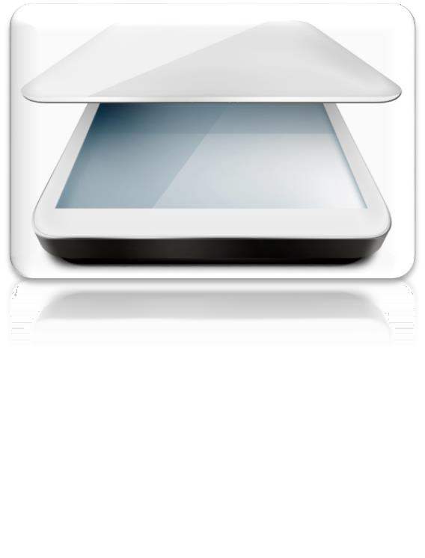
Input Device : Scanner
An input device, that digitizing an image
It has a light source and a set of optical sensors
Reflected light is sensed by the sensors & converted into digital signal

Slide 3
Scanners : Classification
Flatbed Scanners
Sheet-fed Scanners
Handheld Scanners
Drum Scanners
On Scan Technology
On Dimension
2D Scanners
3D Scanners

Slide 4


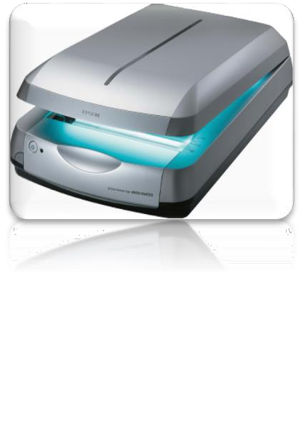
Scanner : Flatbed
Also known as desktop scanner
The most commonly used scanner
Document is stationary
Head is movable

Slide 5




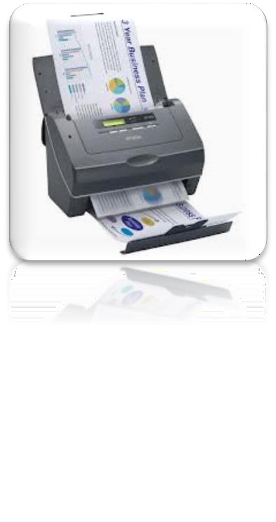
Scanner : Sheet-fed
Desktop scanner
Document is movable
Head is stationary

Slide 6

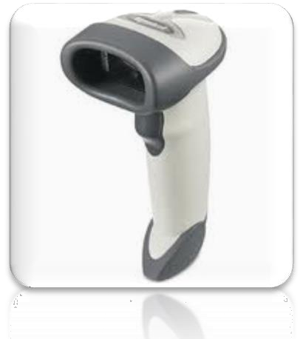
Scanner : Handheld
Movable scanner
Can be hold by hand
Can be used for quick scan
Scan quality is not much better
E.g. Barcode reader

Slide 7

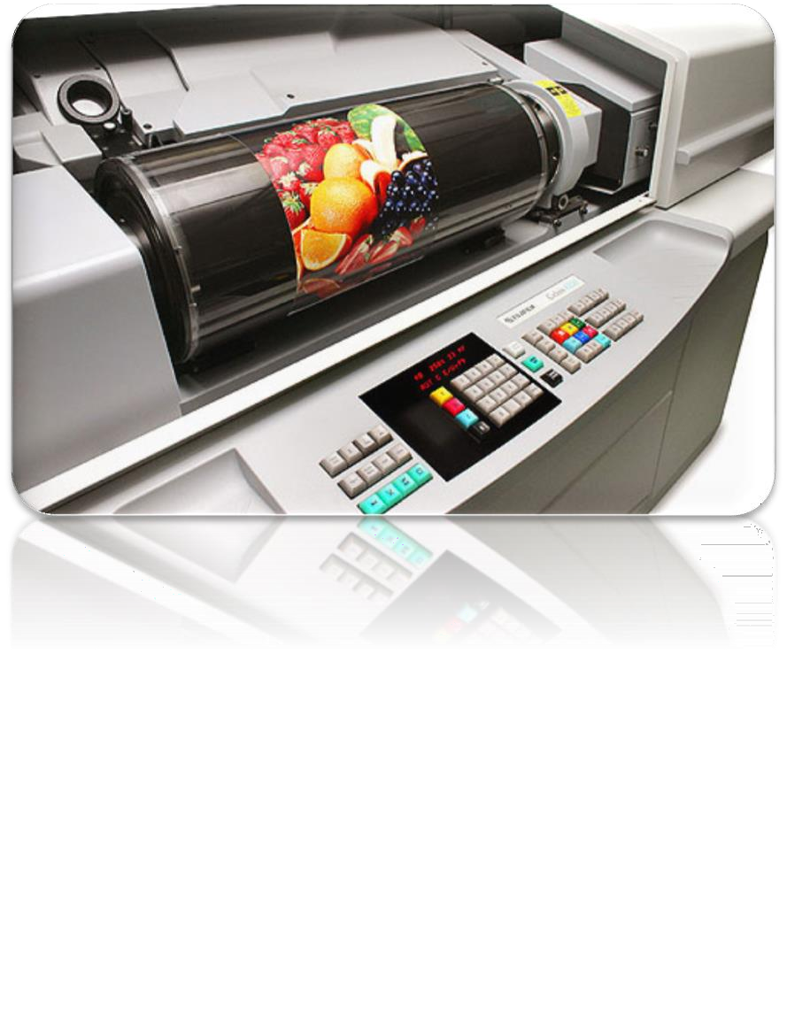
Scanner : Drum
Used in graphics production houses
Used for scanning a large size of image

Slide 8

















Anatomy : Flatbed Scanner
Basic components of a flatbed scanner are:
Charged Coupled Device (CCD) Array
Mirrors
Lamp
Lens
Filter
Scan Head assembly
Mother board
Control Panel
Frame

Slide 9
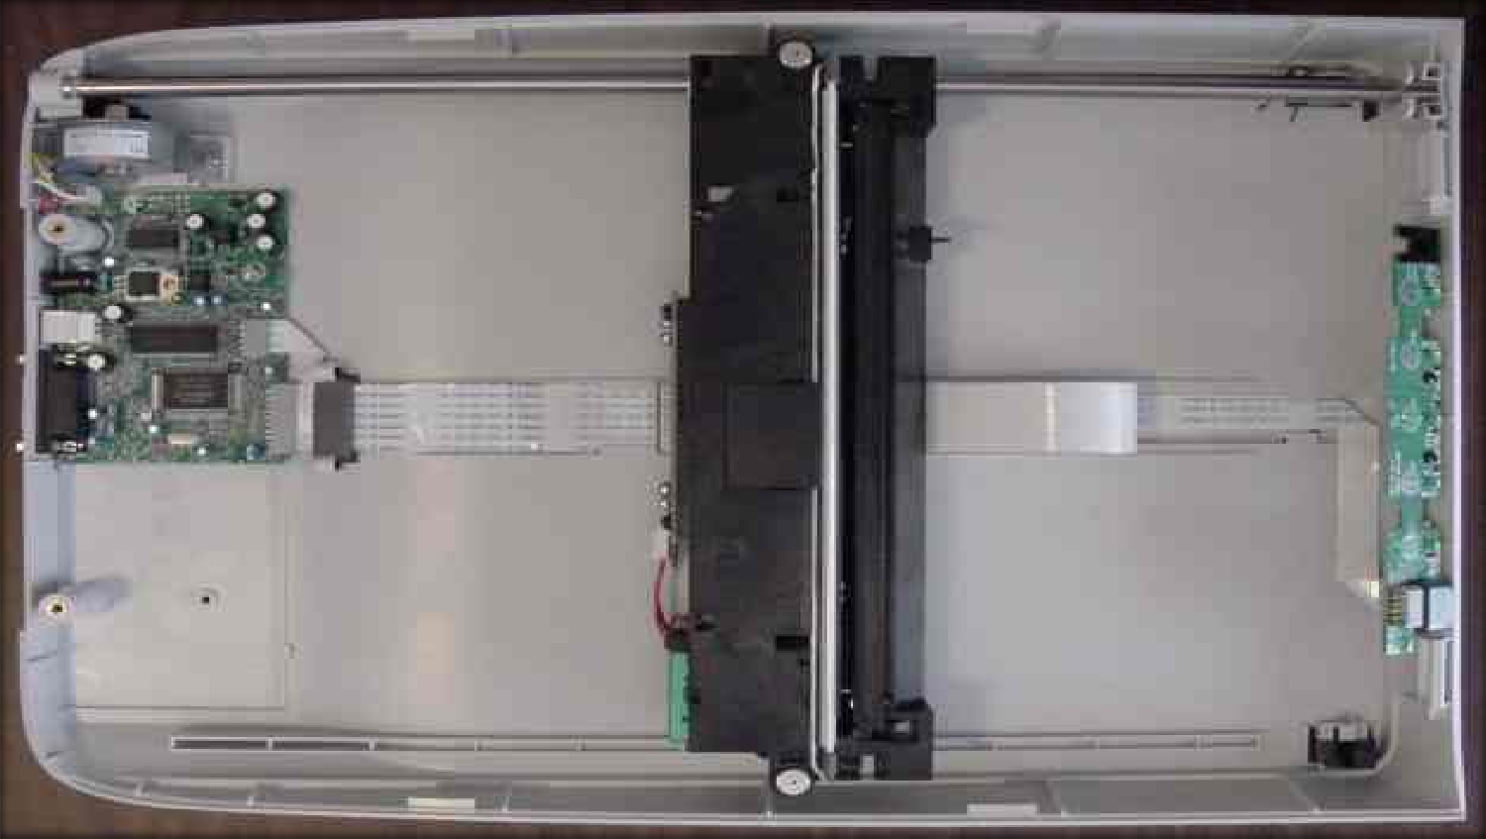
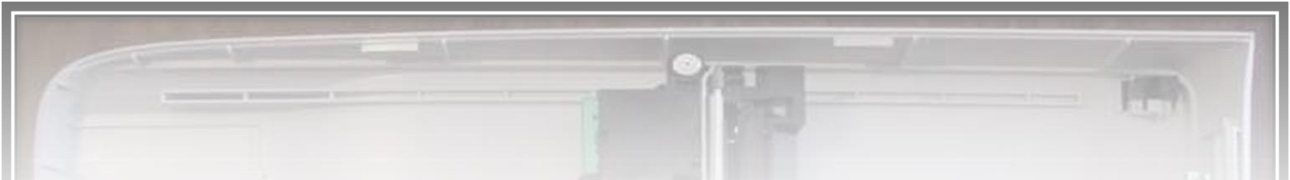
Anatomy : Flatbed Scanner
Motherboard
Head Assembly
Control Panel

Slide 10





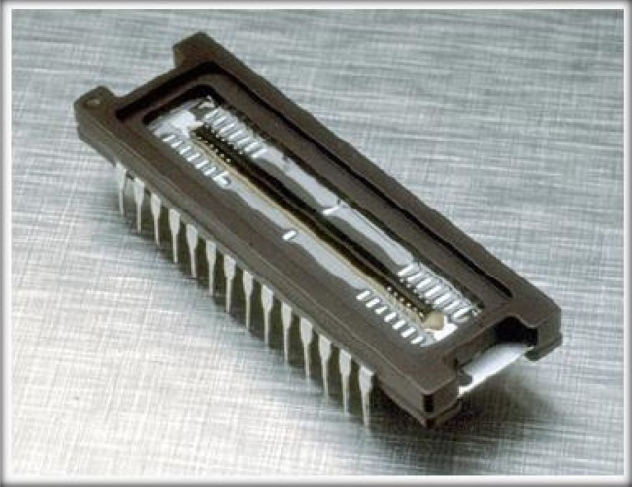
Anatomy : Flatbed Scanner
CCD Array (image sensor) is the main component of a scanner
CCD is a set of light sensitive diode known as photosites
CCD converts photons into electrons
CCD Array
10

Slide 11


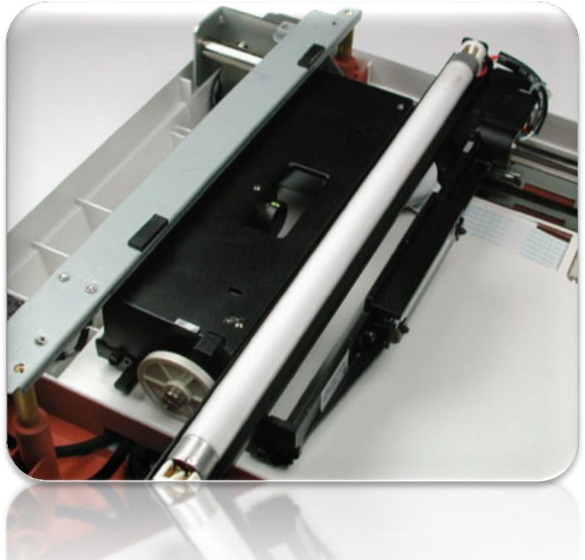
Anatomy : Flatbed Scanner
The document is placed and cover is closed
A lamp is used to illuminate the document
The scan head is moved slowly across the document
Lamp
11

Slide 12







Anatomy : Flatbed Scanner
The image of the document is reflected by a mirror (1st one)
That reflected image, is reflected by two other mirrors
The last mirror reflects the image onto a lens
The lens focuses the image through a filter on the CCD Array
The purpose of three mirrors in a scanner to reduce extra light intensity
12

Slide 13
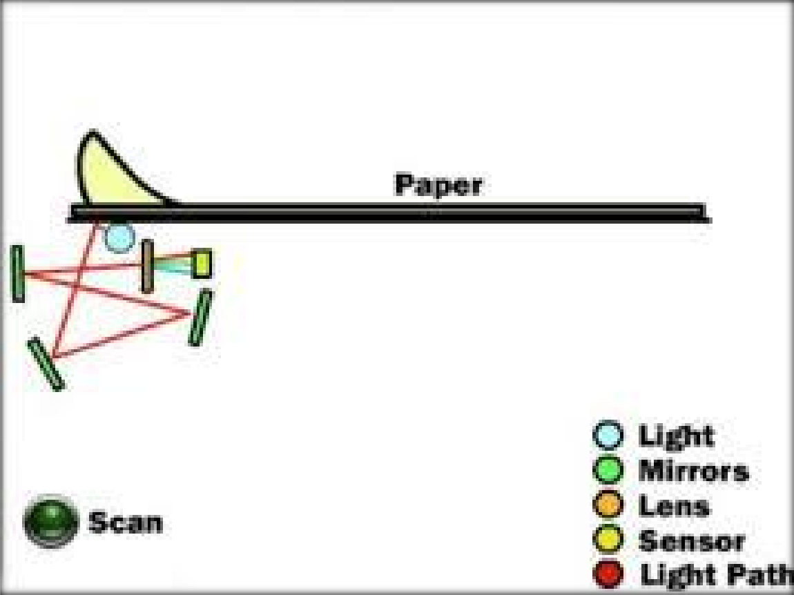
Anatomy : Flatbed Scanner
13

Slide 14


Thank You

